Slide 1
Unit 2: CERT Organization
CERT Basic Training

Slide 2
Unit 2 Objectives
Describe the CERT organizational structure
Explain the Incident Command System (ICS) and how CERT operates within this structure
Describe the 9-step one-scene size-up process
Describe how to use CERT standard documents
PM 2-1
CERT Basic Training Unit 2: CERT Organization
2-1

Slide 3
Principles of On-Scene Management
Maintain the safety of disaster workers
Provide clear leadership and organizational structure
Improve effectiveness of rescue efforts
PM 2-2
CERT Basic Training Unit 2: CERT Organization
2-2

Slide 4
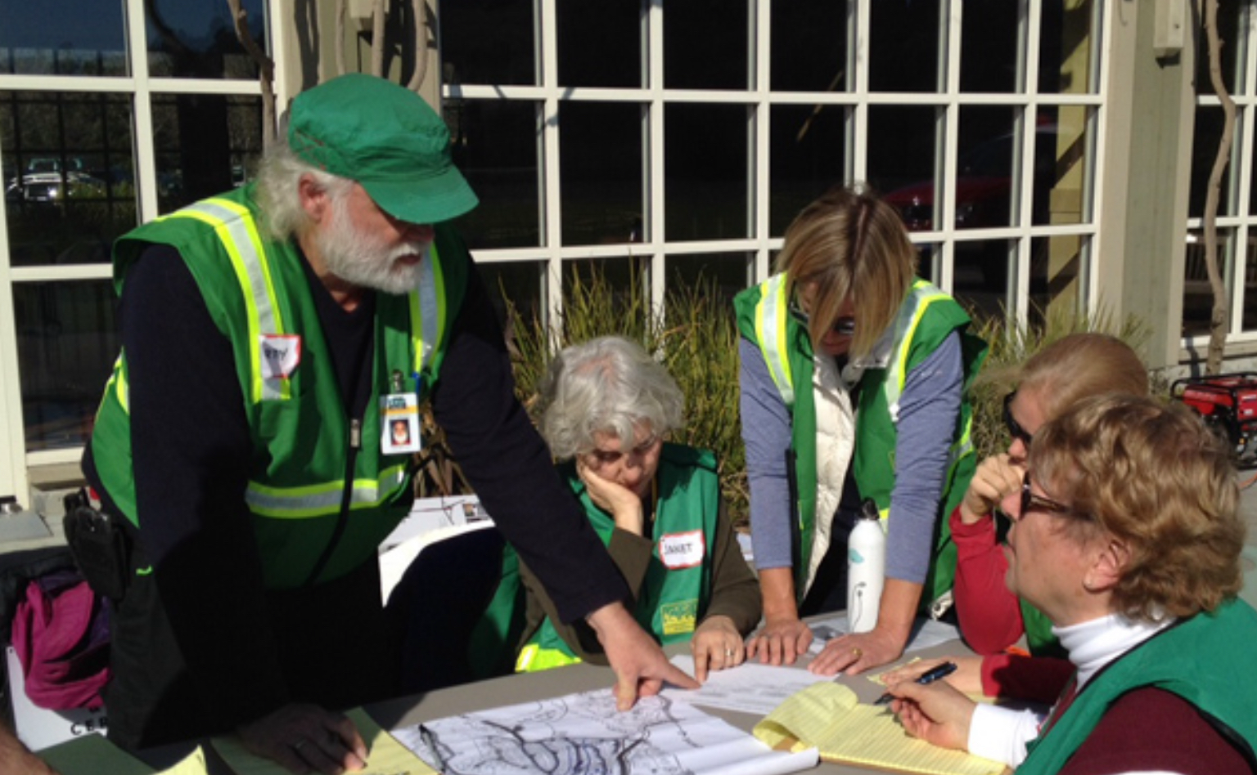
On-Scene Management
Well-defined management structure
Manageable span of control
Common terminology
Effective communication
Consolidated action plans
Comprehensive resource management
Accountability
PM 2-2
CERT Basic Training Unit 2: CERT Organization
2-3

Slide 5
Objectives for On-scene Management
Identify scope of incident
Determine overall strategy
Set priorities
Deploy resources
Document actions and results

Slide 6
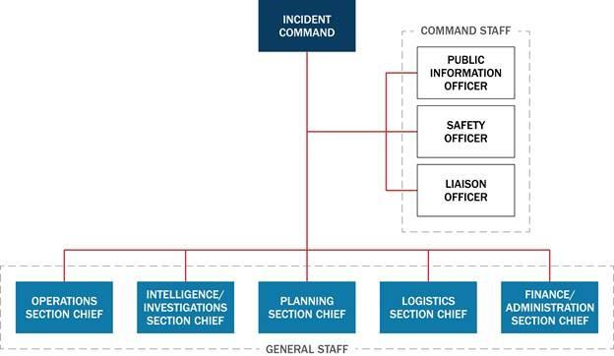
Incident Command System
PM 2-3
CERT Basic Training Unit 2: CERT Organization
2-5
Notes:
On this slide quickly explain Intelligence & Finance & that rarely used by CERT.

Slide 7
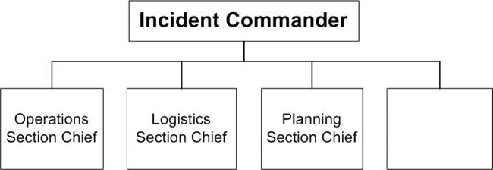
Incident Command System
Finance &
Intelligence
Chiefs
The “Doers”
Fire Suppression
Search & Rescue
Medical Operations
The “Getters” & Communications
The “Thinkers”
Planning,
People, Paper
Rarely Needed
By CERTs
PM 2-3
Notes:
Next slide will be CERT in Action video

Slide 8


Slide 9
CERT Incident Operations
Command structure
CERT Team Leader
Command Post
Expanded structure as needed
PM 2-5
CERT Basic Training Unit 2: CERT Organization
2-6

Slide 10
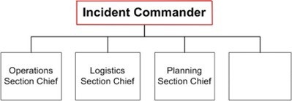
CERT Incident Command
IC/Team Leader
Finance & Intelligence Chiefs
First person at staging area is Incident Commander/Team Leader
IC/TL directs team activities and ensures incident safety
Sets up Command Post and stays there
Assigns workers to head Operations, Logistics, & Planning
Interfaces with Media and other Responders (Fire, Police, etc.)
Takes direction from Agency official
PM 2-4

Slide 11
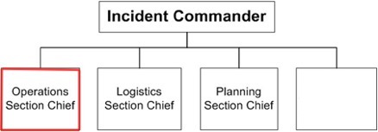
CERT Operations
IC/Team Leader
Finance & Intelligence Chiefs
Typically one of the first functions assigned
Directs and coordinates all tactical operations:
  Fire
  Search & Rescue
  Medical Operations
Documents team briefings and assignments
PS 2-5

Slide 12
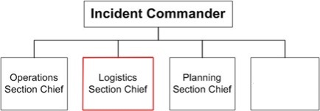
CERT Logistics
IC/Team Leader
Finance & Intelligence Chiefs
Provides Communications
Provides food and medical support to Team members
Coordinates with Operations to determine needs
Manages supplies and facilities
Documents equipment, supplies and facilities
PM 2-4

Slide 13
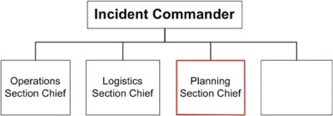
CERT Planning
IC/Team Leader
Finance & Intelligence Chiefs
Tracks Resources (CERT members and other volunteers who have reported in)
Tracks situation status (incident & staging locations, routes, hazards)
Prepares Team’s action plan & alternative strategies
PM 2-4

Slide 14
CERT Planning
IC/Team Leader
Finance & Intelligence Chiefs
Provides documentation services to other Sections
Maintains Personnel Resources Tracking Log
PM 2-4

Slide 15
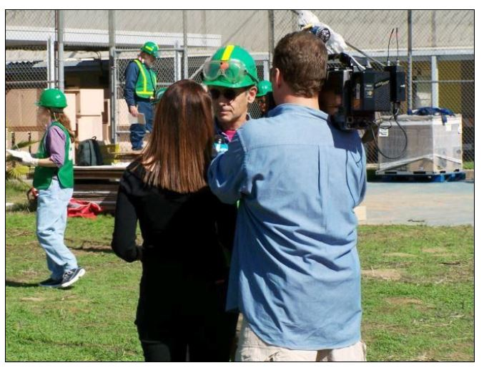
Dealing with the Media
Refer media inquiries to CERT IC/Team Leader
Do not let media inhibit CERT goals
Be careful about information released
Social media pitfalls
PM 2-6
CERT Basic Training Unit 2: CERT Organization
2-7

Slide 16
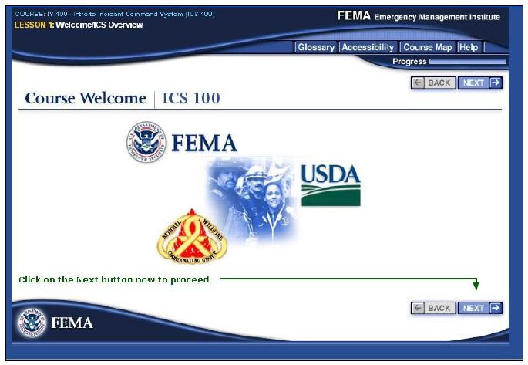
NIMS Implementation
Ability to work together
IS-100: Introduction to ICS
  https://emilms.fema.gov/IS100c/curriculum/1.html
IS-700: Introduction to NIMS
  https://emilms.fema.gov/IS700b/curriculum/1.html
PM 2-6
CERT Basic Training Unit 2: CERT Organization
2-8
Notes:
Hidden. Too early for this

Slide 17
Exercise 2.1
Using your knowledge about the ICS functions, decide under which function the following CERT activities would fall. Some activities may involve more than one function to be completed
Use the following key to fill in the blanks before each activity:
  Team Leader = TL
  Operations = O
  Planning = P
  Logistics = L
PM 2-6
CERT Basic Training Unit 2: CERT Organization
2-9
Notes:
Tentative exercise. See pages 2-6 and 2-7 in participant manual

Slide 18
CERT Mobilization
CERTs take care of themselves, their families, their homes, their neighbors first
Proceed to predesignated staging area if activated
TL is established, organizes the group
TL prioritizes actions
Organization is flexible and evolves based on new information
PM 2-8
CERT Basic Training Unit 2: CERT Organization
2-10
Notes:
Add in fire branch slide maybe. Think about a map image. Ask Paul Garcia for a better map visual

Slide 19
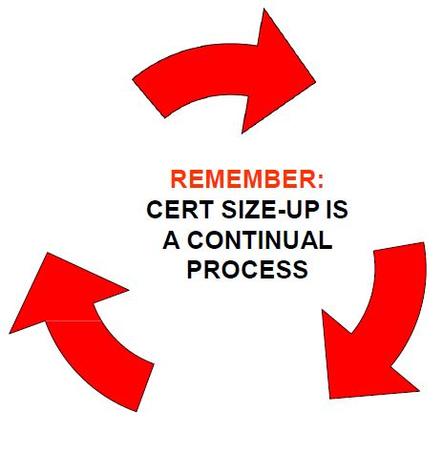
On-Scene Size-up
Gather Facts
Assess and Communicate Damage
Consider Probabilities
Assess Your Own Situation
Establish Priorities
Make Decisions
Develop Plan of Action
Take Action
Evaluate Progress
PM 2-9
CERT Basic Training Unit 2: CERT Organization
2-11
Notes:
Have them follow this in the book

Slide 20
Rescuer Safety
Rescuer safety = first priority
Heavy damage = No rescue
Moderate damage = Locate, assess, evacuate
Light damage = Locate, assess, continue size-up, and document
PM 2-10
CERT Basic Training Unit 2: CERT Organization
2-12

Slide 21
Documentation
Command Post
  Documents situation status
    Incident locations
    Access routes
    Identified hazards
    Support locations
Section Chiefs
  Provide Command Post with information
PM 2-11
CERT Basic Training Unit 2: CERT Organization
2-13

Slide 22

Documentation (image)
PM 2-11
CERT Basic Training Unit 2: CERT Organization
2-14
Notes:
Who, what, when, where, why, & how many?

Slide 23
Documentation Forms
Damage Assessment
Personnel Resources Sign-In
CERT Assignment Tracking Log
Briefing Assignment
Treatment Area Record
Communications Log
Equipment Inventory
General Message
PM 2-13
2-15
Notes:
Have them look at forms in Binder pgs 2-14 thru 2-22. Then show the 4 WE use most often

Slide 24
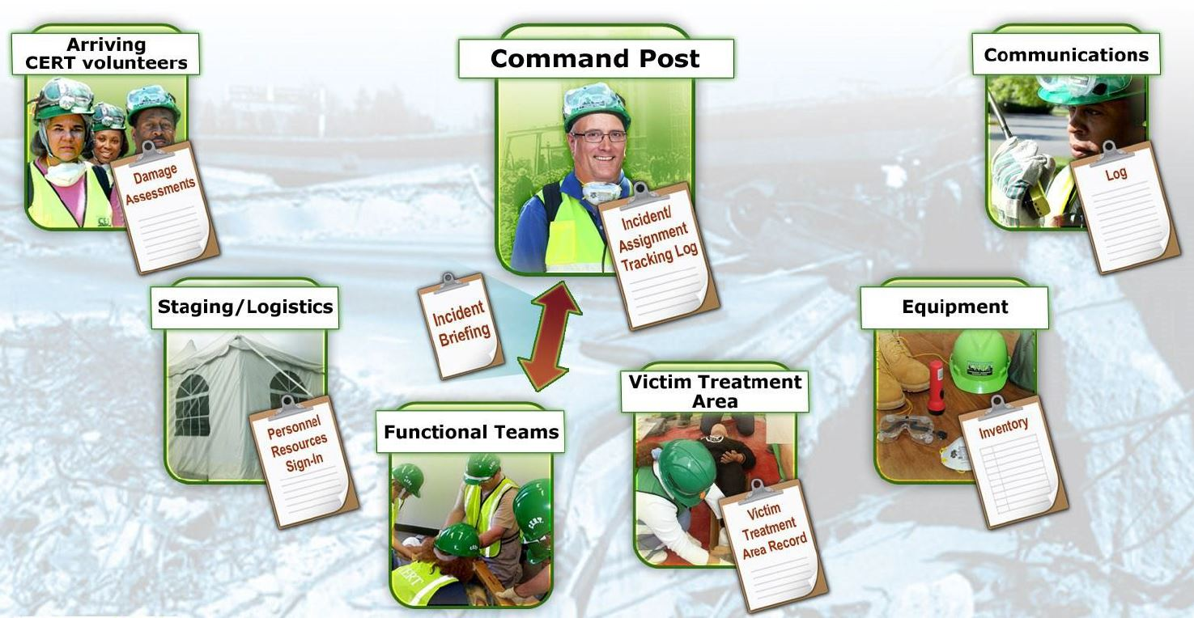
Documentation Flow (5 of 5)
PM 2-13
CERT Basic Training Unit 2: CERT Organization
2-20

Slide 25
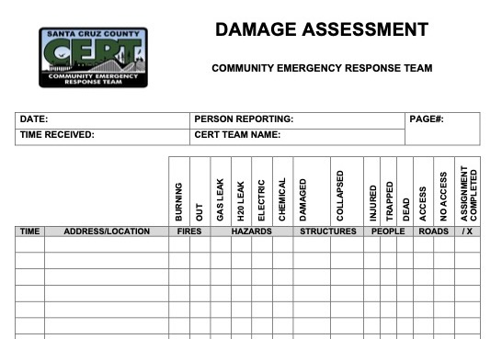
CERT Damage Assessment
  To be filled out as you go to CP or staging
  Also used in squad surveys of neighborhood
  Used to help prioritize problems
PM 2-14
Notes:
This is the form our Fire Depts want us to use

Slide 26
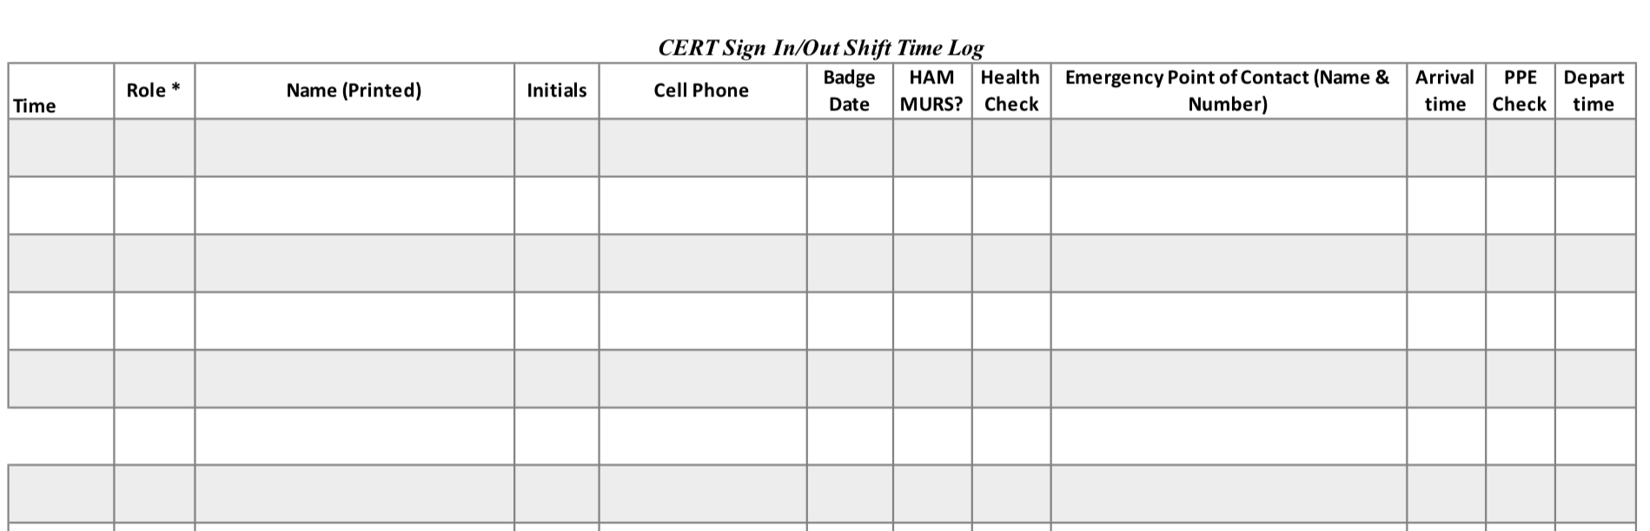
CERT Personnel
Resources
Form 2 (Our County version)
Track CERT and Spontaneous Untrained Volunteers (SUV) personnel at sign-in
Info requested by OR3
PM 2-15
Notes:
START HERE

Slide 27
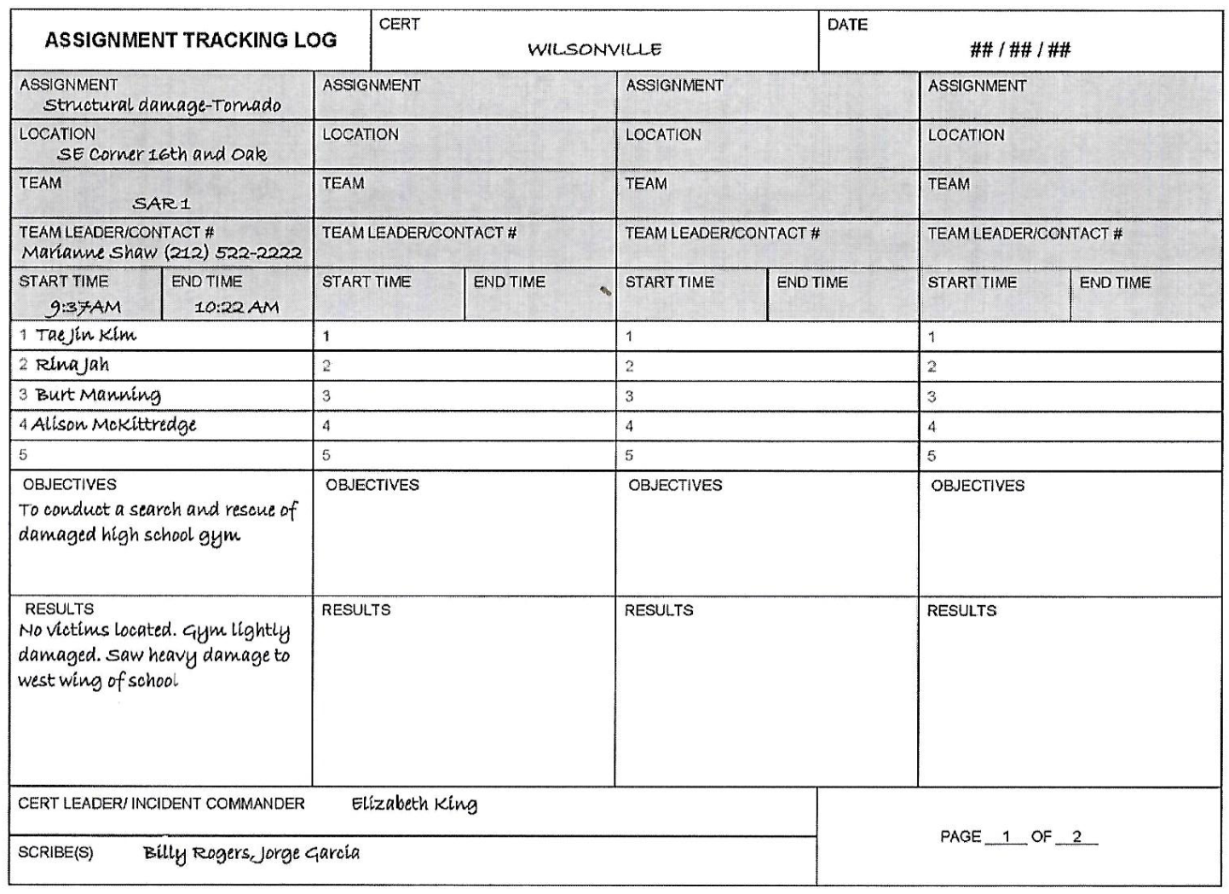
CERT Assignment
Tracking
Form 3
Documents what each team has done
Should match up with Form 2
PM 2-16
Notes:
START HERE

Slide 28
ICS 214
Documents what each team has done
Used by Fire/Police
Communication passed on to next shift/Team Leader
PM 2-16
Notes:
START HERE

Slide 29
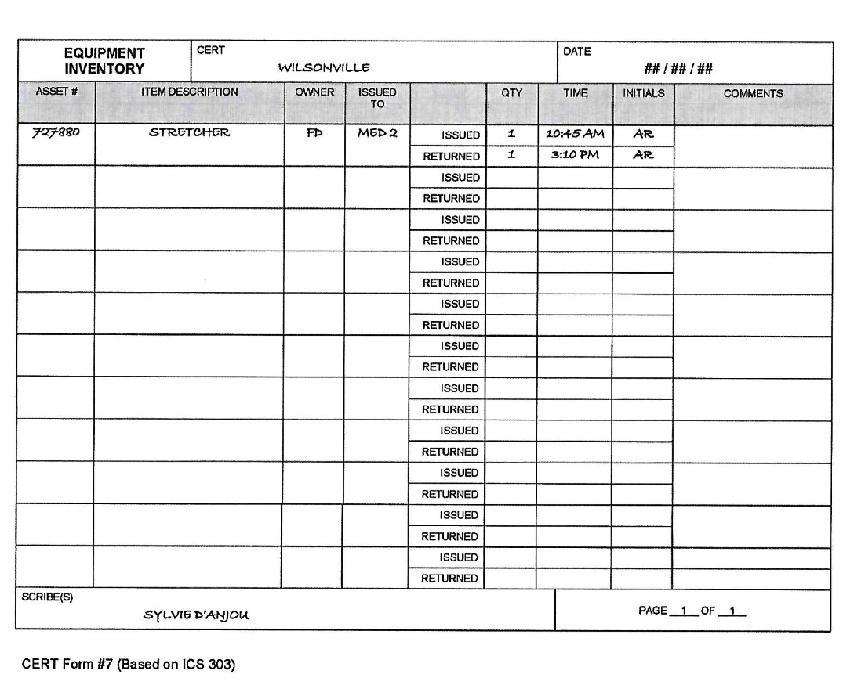
CERT Equipment
Inventory
Form 7
What you have and where it is
Helps identify needs you do not have
PM 2-20 thru 22
Notes:
START HERE

Slide 30
Unit Summary (Unit 2)
ICS provides flexible means of organization
Ask “Is it safe?”
Document and communicate information to all CERT levels
Provide Command Post with ongoing information about damage assessment, group status, and needs
Command Post documents and tracks situation status
PM 2-25
CERT Basic Training Unit 2: CERT Organization
2-21

Slide 31
Homework Assignment (Unit 2)
Read Unit 3 (Disaster Medical Part 1) to be covered in next session
Bring unusual splinting materials
Wear appropriate clothes to next session
CERT Basic Training Unit 2: CERT Organization
2-22

